Slide 1
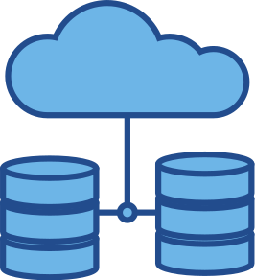
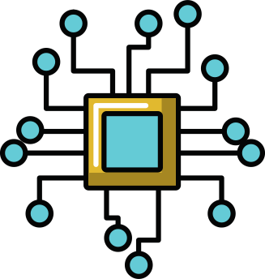
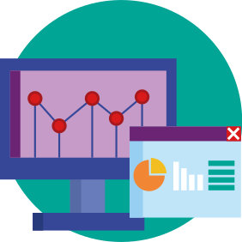
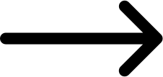
Data Source
Predictive Model
Hospital App

Slide 2





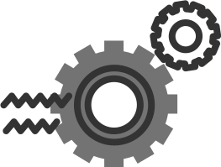


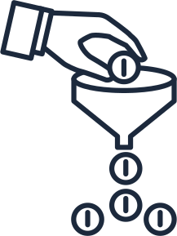
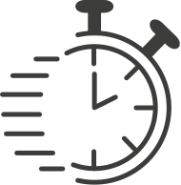


Read data and model list
EDA: Select rows & columns
Data Encoding: Create dummy variable
Vectorization of model features
Congifure the regression algorithm
Split: Training/Testing
Initialize the ML Model
Features Selection: dropping unrequired variables
Iterate model: Cross-validation on Train dataset and hyper-parameter tuning
Model Accuracy
Model Evaluation
Model deployment
Predictive Model

Slide 3




Read data and model list
EDA: Select rows & columns
Data Encoding: Create dummy variable
Vectorization of model features
Congifure the regression algorithm
Split: Training/Testing
Initialize the ML Model
Features Selection: dropping unrequired variables
APP UI
Data Source
Iterate model: Cross-validation on Train dataset and hyper-parameter tuning
Model Accuracy
Model Evaluation
Model deployment
Inference Engine
Process Flow for Hospital App

Slide 4



NZ Hospital Forecast
Search
1
Results
3
Records
Click and insert records
2
PREDICT

Slide 5
Input Field Section
This section the end user interacts with the system by navigating and inserting patient data records
NZ Hospital Forecast
Search
Results
Records
1
3
Click and insert records
Result Section
This section displays results of forecast based on the records provided by the end-user
Predict Button
By clicking the "Predict" button, the system will forecast the estimate the date of discharge based on the record inputs provided by the end-user
2
PREDICT

Slide 6
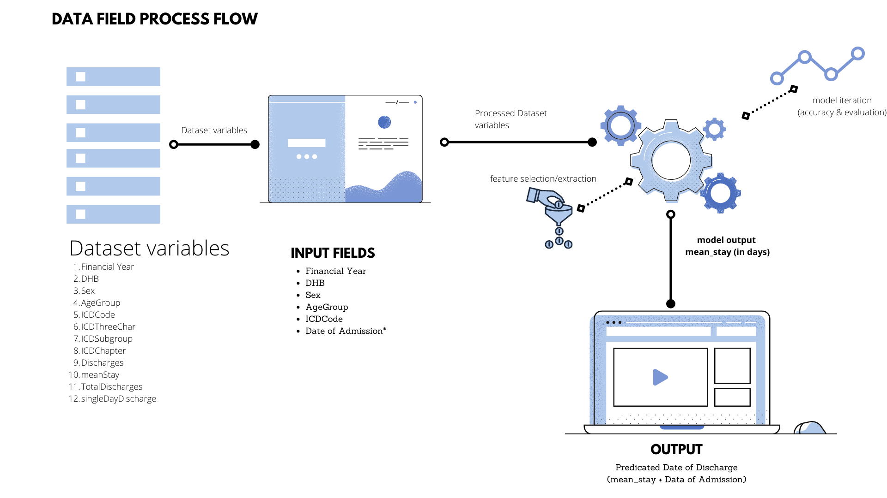

Slide 7
